Slide 1
Service Configuration and Coordination Systems
Pravin Y Pawar

Slide 2
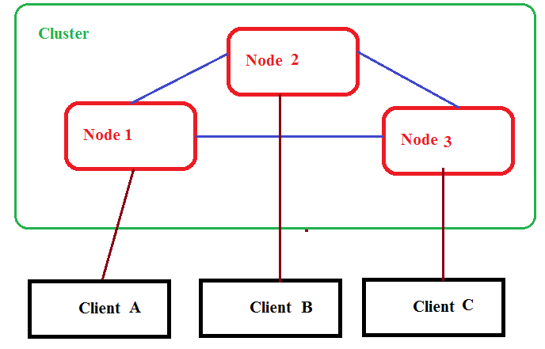
Distributed Applications
Overview
Run on multiple systems in a network at a given time simultaneously
Systems coordinates among themselves to carry out task in fast and efficient manner
Collection of systems is “Cluster”
System is termed as “Node”
Client communicates with the systems in cluster

Slide 3
Motivation for Configuration and Coordination System
Need
Applications needs to share the metadata and state
Metadata is configuration information
Example, location of various database shards in server
System state is data used to coordinate the application
Example, server currently acting as master

Slide 4
Motivation for Configuration and Coordination System (2)
Need (Continued)
Managing metadata and state is too difficult
Often leads to incorrect server behavior
Causes unaccepted delays in processing or missed the processing entirely
Needs a system-wide service that correctly and reliably implements distributed configuration and coordination

Slide 5
Distributed State Management
Challenges
Unreliable network connections
Clock Synchronization
Consistency in applications state

Slide 6
Distributed State Management (2)
Unreliable network connections
Networks are unreliable
Latency varies from time to time
Bandwidth changes
Connections are lost
Split brain problem
Loss of connectivity between two groups of systems
Some amount of state is inaccessible
Disallow changes to distributed state until connectivity restored back
Allow one partition to remain functional while degrading the capabilities of other partition

Slide 7
Distributed State Management(3)
Clock Synchronization
Depending upon type of application, synchronization needs to be precise
Hardware clocks in servers not perfect and tend to drift over time
May lead to disordering in the events

Slide 8
Distributed State Management(4)
Consistency in applications state
State in distributed system has to be consistent in any case of failure
Paxos algorithm or Multi-Paxos helps in maintaining the state
But notoriously difficult to implement
Recommended to use systems that already has implementations for the same

Slide 9
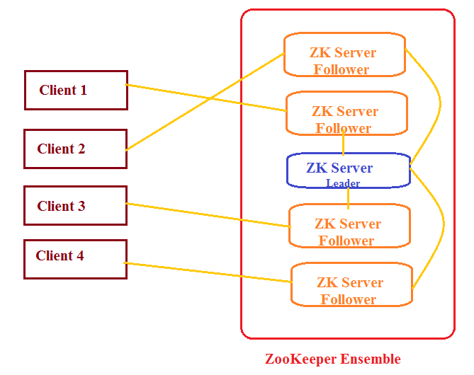
Example System
Apache ZooKeeper
Designed at Yahoo!
Distributed co-ordination service to manage large set of hosts
Simple architecture and API to manage a service in a distributed environment
Standard for organized service used by Hadoop, HBase, and other distributed frameworks

Slide 10
Apache ZooKeeper
Pravin Y Pawar
CSIS-WILP

Slide 11
BA ZC420, Real Time Analytics
Lecture No. 2.2

Slide 12

Agenda
Apache ZooKeeper Fundamentals
ZooKeeper Workflow
ZooKeeper CLI
ZooKeeper Java APIs

Slide 13
Apache ZooKeeper
Overview
Designed at Yahoo!
Distributed co-ordination service to manage large set of hosts
Simple architecture and API to manage a service in a distributed environment
Standard for organized service used by Hadoop, HBase, and other distributed frameworks

Slide 14
Apache ZooKeeper Fundamentals
ZooKeeper Services
Naming service
Helps in identifying the nodes in a cluster by name
Configuration management
Provides latest and up-to-date configuration information of system
Cluster management
Managing the addition / deletion of nodes and their status
Leader election
Helps in electing a node as leader for coordination purpose
Locking and synchronization service
Helps in automatic fail over recovery
Highly reliable data registry
Makes data available even when one or more nodes are down

Slide 15
Apache ZooKeeper Fundamentals
Benefits of ZooKeeper
Simple architecture of distributed coordination process
Synchronization
Helps in coordination between the server processes
Serialization
Ensure your application runs consistently
Reliability
As no single point of failure in system
Atomicity
Data transfer either succeed or fail completely, but no transaction is partial.

Slide 16
Apache ZooKeeper Fundamentals
Architecture

Slide 17
Apache ZooKeeper Fundamentals
Architectural Components
Client
Node in distribution application, tries to connect to server in ensemble.
Sends heartbeat message to server to maintain the connection
In response, server sends message back to client, otherwise client connects to other server
Server
Node in our ZooKeeper ensemble, provides all the services to clients
Gives acknowledgement to client to inform that the server is alive.
Ensemble
Cluster of ZooKeeper servers. The minimum number of nodes - 3.
Leader
Server node which performs automatic recovery if any of the connected node failed.
Leaders are elected on service startup.
Follower
Server node which follows leader instruction.
https://zookeeper.apache.org/doc/r3.5.0-alpha/zookeeperOver.html

Slide 18
Apache ZooKeeper Fundamentals
Hierarchical Namespace
ZooKeeper node is referred as znode.
Every znode is identified by a name and separated by a sequence of path .
Each znode can store upto 1MB of data
The main purpose of this structure is to store synchronized data and describe the metadata of the znode.
Every znode in the ZooKeeper data model maintains a stat structure.
A stat simply provides the metadata of a znode. It consists of Version number, Action control list , Timestamp, and Data length

Slide 19
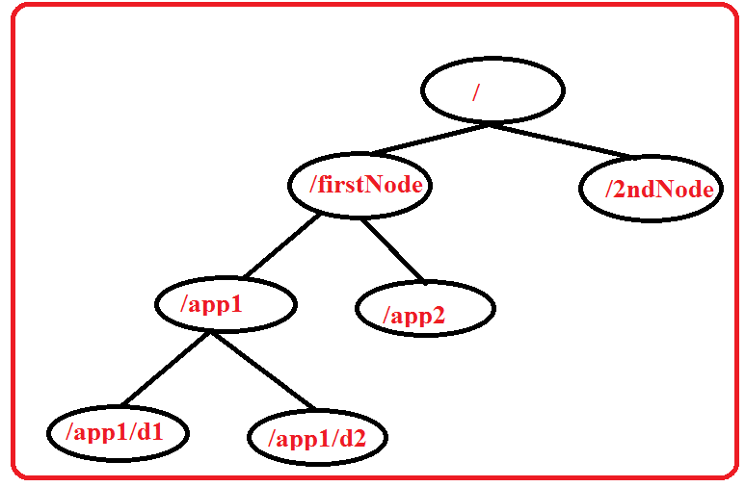
Apache ZooKeeper Fundamentals
Hierarchical Namespace(2)

Slide 20
Apache ZooKeeper Fundamentals
Types of Znodes
Persistence znode
Ephemeral znode
Sequential znode

Slide 21
Apache ZooKeeper Fundamentals
Persistence znode
is alive even after the client, which created that particular znode, is disconnected.
By default, all znodes are persistent.
Ephemeral znode
are active until the client is alive.
When a client gets disconnected from the ZooKeeper ensemble, then the ephemeral znodes get deleted automatically.
are not allowed to have a children further
play an important role in Leader election

Slide 22
Apache ZooKeeper Fundamentals
Sequential znode
can be either persistent or ephemeral
ZooKeeper sets the path of the znode by attaching a 10 digit sequence number to the original name.
For example, if a znode with path /myapp is created as a sequential znode, ZooKeeper will change the path to /myapp0000000001 and set the next sequence
number as 0000000002.
Sequential znodes play an important role in Locking and Synchronization.

Slide 23
Apache ZooKeeper
Sessions
Requests in a session are executed in FIFO order.
Once a client connects to a server, the session will be established and a session id is assigned to the client.
The client sends heartbeats at a particular time interval to keep the session valid.
If the ZooKeeper ensemble does not receive heartbeats from a client for more than the period specified at the starting of the service, it decides that the client died.
When a session ends for any reason, the ephemeral znodes created during that session also get deleted.

Slide 24
Apache ZooKeeper
Watches
Simple mechanism for the client to get notifications about the changes in the ZooKeeper ensemble.
Clients can set watches while reading a particular znode.
Watches send a notification to the registered client for any of the znode changes.
Znode changes are modification of data associated with the znode or changes in the znode’s children.
Watches are triggered only once.
If a client wants a notification again, it must be done through another read operation.
When a connection session is expired, the client will be disconnected from the server and the associated watches are also removed.

Slide 25
ZooKeeper Workflow – Connection
Connecting to Server
Once a ZooKeeper ensemble starts, it will wait for the clients to connect.
Clients will connect to one of the nodes in the ZooKeeper ensemble. It may be a leader or a follower node.
Once a client is connected, the node assigns a session ID to the particular client and sends an acknowledgement to the client.
If the client does not get an acknowledgment, it simply tries to connect another node in the ZooKeeper ensemble.
Once connected to a node, the client will send heartbeats to the node in a regular interval to make sure that the connection is not lost.

Slide 26
ZooKeeper Workflow – Read
Reading data from znode
If a client wants to read a particular znode, it sends a read request to the node with the znode path and the node returns the requested znode by getting it from its own database.
For this reason, reads are fast in ZooKeeper ensemble.

Slide 27
ZooKeeper Workflow – Write
Writing to znode
If a client wants to store data in the ZooKeeper ensemble, it sends the znode path and the data to the server.
The connected server will forward the request to the leader and then the leader will reissue the writing request to all the followers.
If only a majority of the nodes respond successfully, then the write request will succeed and a successful return code will be sent to the client.
Otherwise, the write request will fail. The strict majority of nodes is called as Quorum.

Slide 28
ZooKeeper Workflow – nodes failure
Nodes in a ZooKeeper Ensemble
If we have a single node, then the ZooKeeper ensemble fails when that node fails. It contributes to "Single Point of Failure" and it is not recommended in a production environment.
If we have two nodes and one node fails, we don’t have majority as well, since one out of two is not a majority.
If we have three nodes and one node fails, we have majority and so, it is the minimum requirement. It is mandatory for a ZooKeeper ensemble to have at least three nodes in a live production environment.
If we have four nodes and two nodes fail, it fails again and it is similar to having three nodes. The extra node does not serve any purpose and so, it is better to add nodes in odd numbers, e.g., 3, 5, 7.
A write process is expensive than a read process in ZooKeeper ensemble, since all the nodes need to write the same data in its database. So, it is better to have less number of nodes than having a large number of nodes for a balanced environment.

Slide 29
ZooKeeper Command Line Interface
CLI
ZooKeeper Command Line Interface is used to interact with the ZooKeeper ensemble for development purpose.
Can perform the following operation
Create znodes
Get data
Watch znode for changes
Set data
Create children of a znode
List children of a znode
Check Status
Remove / Delete a znode

Slide 30
ZooKeeper Java API
Basics of ZooKeeper API
Application interacting with ZooKeeper ensemble is referred as ZooKeeper Client or simply Client.
Znode is the core component of ZooKeeper ensemble and ZooKeeper API provides a small set of methods to manipulate all the details of znode with ZooKeeper ensemble.
A client should follow the steps given below to have a clear and clean interaction with ZooKeeper ensemble.
Connect to the ZooKeeper ensemble. ZooKeeper ensemble assign a Session ID for the client.
Send heartbeats to the server periodically. Otherwise, the ZooKeeper ensemble expires the Session ID and the client needs to reconnect.
Get / Set the znodes as long as a session ID is active.
Disconnect from the ZooKeeper ensemble, once all the tasks are completed. If the client is in

Slide 31
ZooKeeper Java API (2)
ZooKeeper Class
The central part of the ZooKeeper API is ZooKeeper class.
It provides options to connect the ZooKeeper ensemble in its constructor and has the following methods -
connect - connect to the ZooKeeper ensemble
create - create a znode
exists - check whether a znode exists and its information
getData - get data from a particular znode
setData - set data in a particular znode
getChildren - get all sub-nodes available in a particular znode
delete - get a particular znode and all its children
close - close a connection

Slide 32


Reference
Apache ZooKeeper Documentation
https://zookeeper.apache.org/
https://zookeeper.apache.org/doc/r3.4.14/
https://www.tutorialspoint.com/zookeeper/zookeeper_api.htm
Real-Time Analytics , Byron Ellis
Chapter 3 : Service Configuration and Coordination

Slide 33
Thank You!
In our next session: Data Flow Manager

Slide 34
Real Time System Characteristics
Pravin Y Pawar

Slide 35
BA ZC420, Real Time Analytics
Lecture No. 1.4

Slide 36
Agenda
Distinguishing Features of Streaming Data
Data always in motion
Data structuring
Data Cardinality
Features of Real-Time Architecture
High Availability
Low Latency
Horizontal Scalability

Slide 37
Distinguishing Features of Streaming Data
Data always in motion
Streaming data
getting generated continuously
Always flowing
Two critical requirements
Collection system should be robust
Processing should be able to keep pace with collection
Solutions
Horizontal Scalability
Algorithmic handling of streaming data

Slide 38
Distinguishing Features of Streaming Data - II
Data Structuring
Loosely structured
Various data sources
structured , unstructured data
Forming a joint schema is difficult
For example, social media streams
Young , evolving projects
Adds many dimensions to the data
Collect as much as data possible to make interesting analysis

Slide 39
Distinguishing Features of Streaming Data - III
Data Cardinality
Number of unique values in data
Very few values appears often, many are very sparce
Challenges with Streaming data
Processing
Streaming data can be processed only once
Difficult to identify state of data
Batch processing on processed data can be used for estimation
Storage
Memory requirements are high while processing data
Linear amount of space required for storing state information

Slide 40
Features of Real-Time Architecture
High Availability
Key distinguishing factor from batch / BI systems
Very critical for collection, flow and processing systems
Two Approaches
Distribution
Use multiple physical servers to distribute the load
Replication
Write to several machines
Master-slave configuration
Automatic failover
Master less configuration
Recovery is difficult in case of failure

Slide 41
Features of Real-Time Architecture - II
Low Latency
Time taken to service a request
Streaming systems latency
Time taken to process the event from the moment it entered the system
Many streaming systems works in batches
Micro batching – processing in very small batches, milli seconds
Collection systems bothers about first definition of latency
Flow and processing components bother about second one
Tradeoff between speed and safety
If data can be safely lost, latency can be very small
If not, needs to live with lower limit of latency

Slide 42
Features of Real-Time Architecture - III
Horizontal Scalability
Adding more physical servers to a clusters
Needs to care about amount of coordination required between the systems
Use of partitioning technique
Use principle of data locality – move program to data

Slide 43
Reference
Real-Time Analytics , Byron Ellis
Chapter 1 : Introduction to Streaming Data
Chapter 2 : Designing Real-Time Streaming Architecture
https://www.cs.cornell.edu/fbs/publications/viveLaDifference.pdf
https://omkarprabhu-98.github.io/2021/03/zab.html

